Slide 1

RESUME SCREENING
NATURAL LANGUAGE PROCESSING IN PYTHON
BATCH - 5
18K41A04C8 Gankidi Nikitha
18K41A05A6 Samanvi Arcot
18K41A04C3 Chinthireddy Sindhu
18K41A04D0 Mohanarupa Guggilla

Slide 2
CONTENT
PROBLEM STATEMENT
INTRODUCTION
SURVEY
IMPLEMENTATION
CONCLUSION
RESULTS & ANALYSIS

Slide 3



PROBLEM STATEMENT
Resume screening is the process of determining whether a candidate is qualified for a role based his or her education, experience, and other information captured on their resume.
It becomes quite tough for hiring teams to read resumes and select the best one based on the requirements
So, we develop a resume screening application that selects the best candidates according to their preferred role. By choosing good candidates, we can increase the company goals exponentially.

Slide 4

INTRODUCTION
When organizations acquire resumes through internet marketing, they sort them into categories based on their needs. Thousands of resumes are typically received by companies. It becomes quite tough for hiring teams to read resumes and select the best one based on the requirements. It is not an issue if there are only one or two resumes, but it is extremely difficult to sort through 1000s of resumes and choose the best one. To address this issue, the corporation always hires a third party whose job it is to create a resume that meets the requirements. Hiring Service Organization is the name given to these businesses. It's all about the resume information screen.

Slide 5


Any company having a job opening for a particular position will have their mail inboxes bombarded with thousands of emails from the aspiring job applicants every single day. Selecting the prospective candidates for that job position from a large pool of candidates for any recruiter is very tedious. It is an extremely daunting task for the recruiters of a company to manually go through thousands of resumes and select the most appropriate candidates for the job. Out of those thousands of resumes submitted to the company for the given job posting, about 75% of them do not showcase the relevant skills that are required for the job profile.

Slide 6
SURVEY:
There have been over 50000 online recruitment sites which ask the job applicant candidates to submit their resumes on their website. In some of these websites classification techniques for screening the resumes are not even employed. It is the job of the company recruiter to go through all the candidate resumes manually. This task is unassumingly daunting for the recruiters to select the most capable candidates for the subsequent rounds of the hiring process. Meanwhile, some recruitment sites have implemented the intelligent concept of automatically rating or classifying the resumes given by the candidates for a particular job position. Some of these websites or web applications are Indeed, Monster.com, Adecco.com, Top resume, Ideal etc[1].
This paper reviews Artificial Intelligence (AI) approaches for automating the HR activities in recruitment process. It focuses on parsing the candidates’ resumes and shortlisting them as selected or rejected. The main concern is that to analyze the resume through various types of aspects and finally shortlisting them on the basis of their analysis. We have designed a system which classifies the resumes’ of applying candidates by considering the skill sets, interests and work experience mentioned in the resume of the candidates [2].

Slide 7
METHODOLOGY :
Now fit the resumes and job description
open website
upload resumes
Compare all the resumes
create Counter Vectorizer
convert docx to text

Slide 8
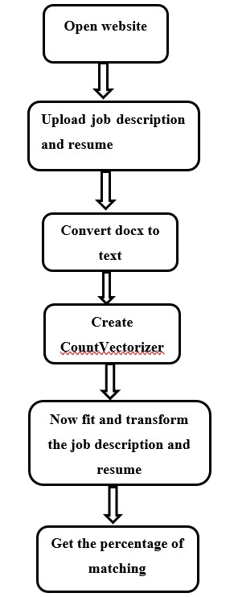

Slide 9
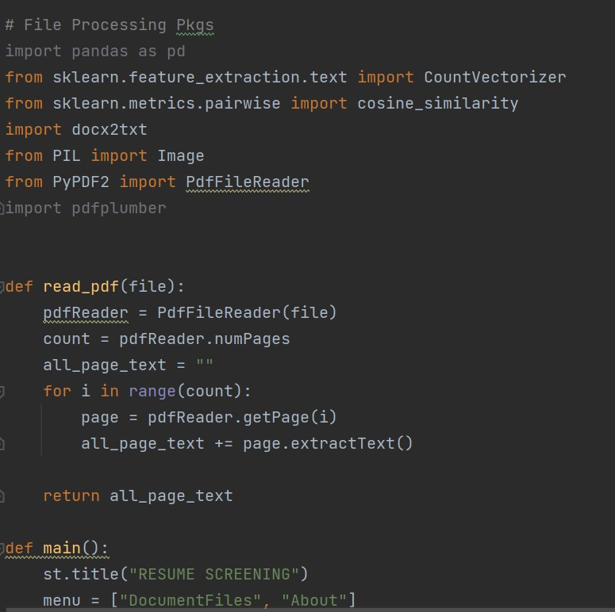
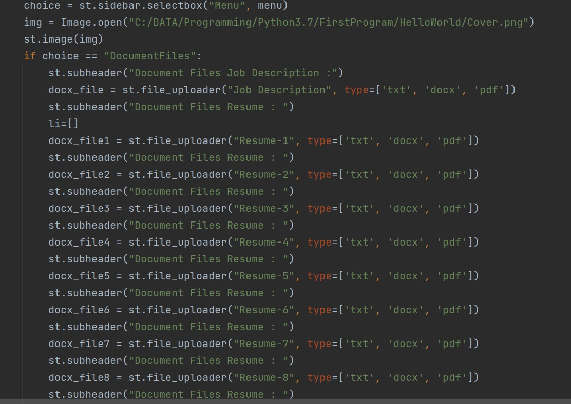
IMPLEMENTATION :

Slide 10
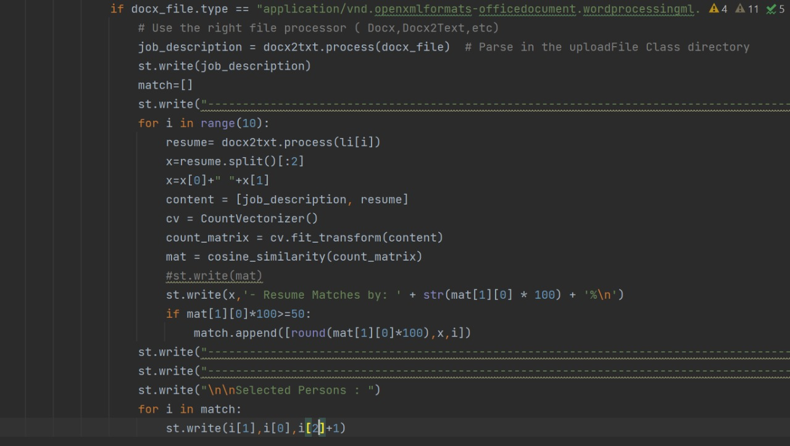
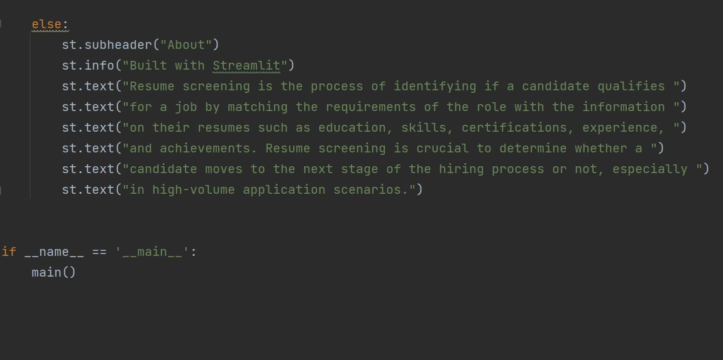

Slide 11
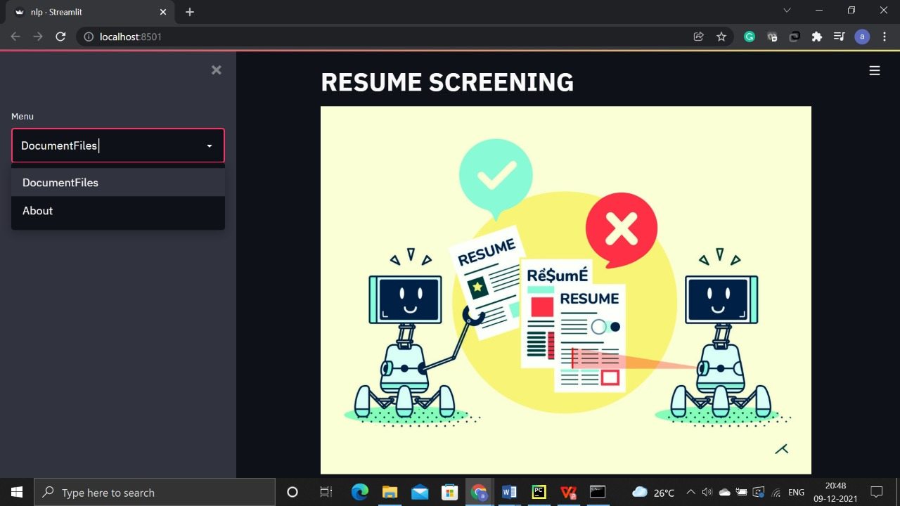
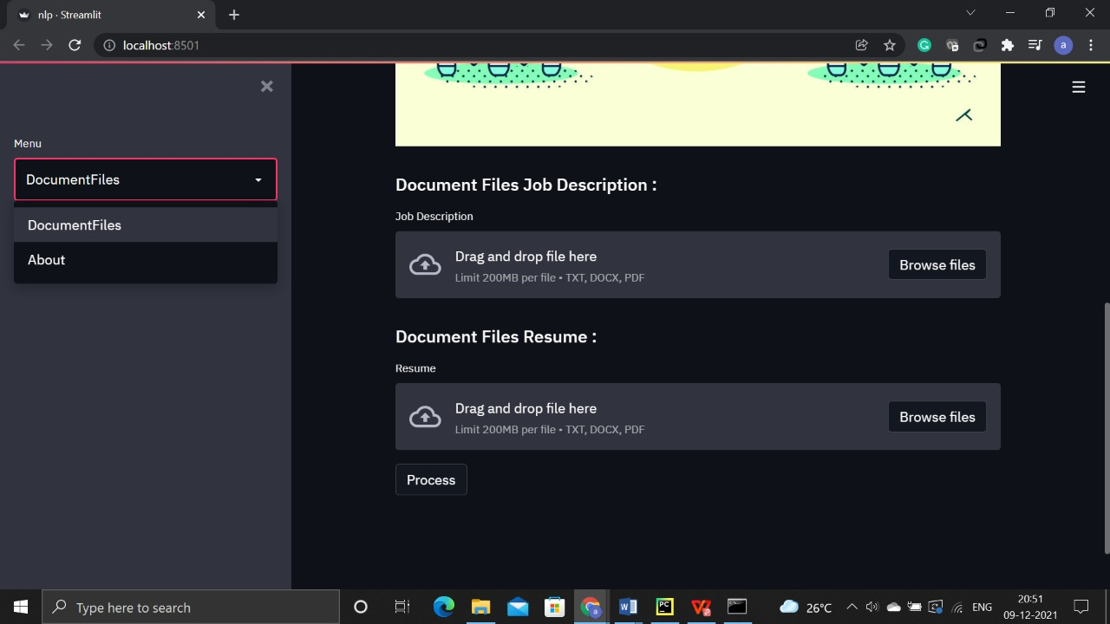
RESULTS AND ANALYSIS

Slide 12
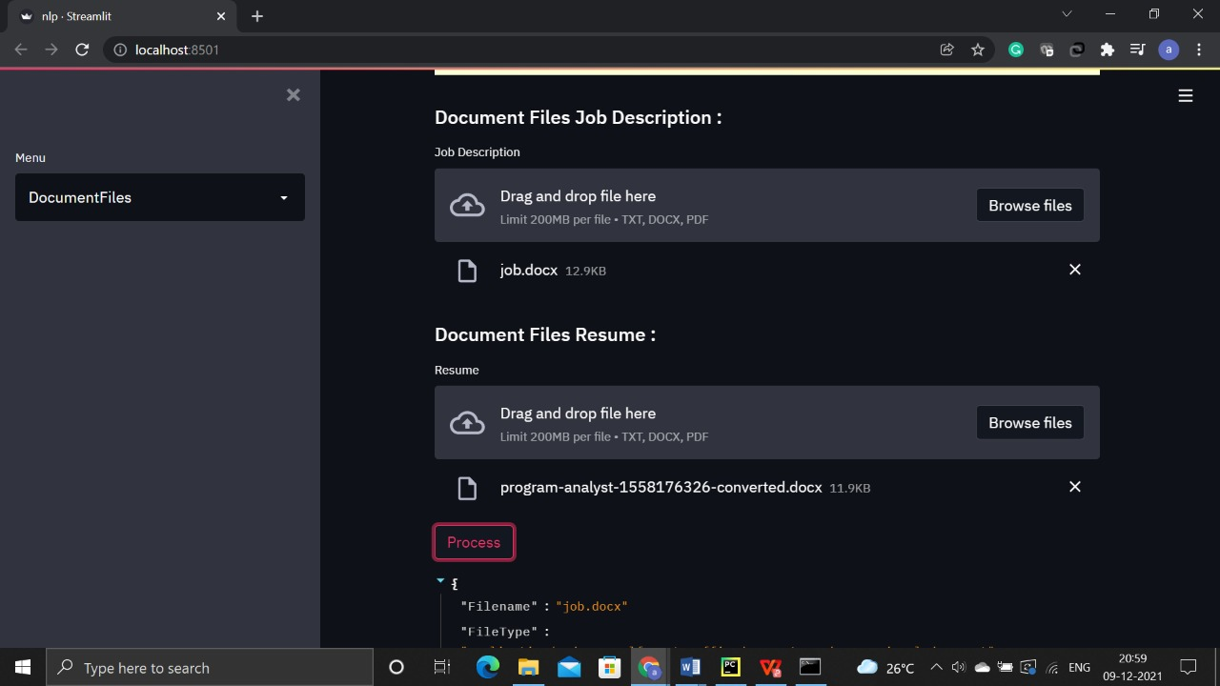
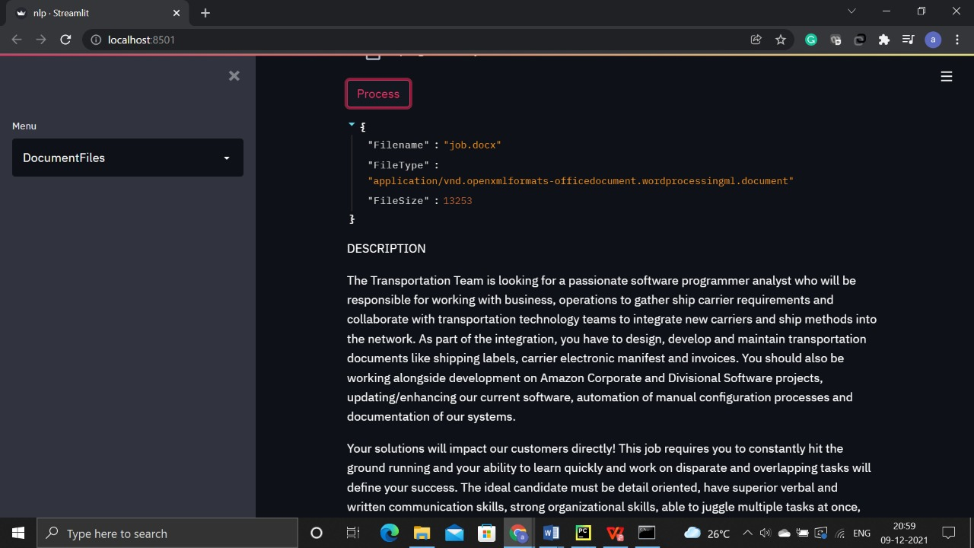

Slide 13
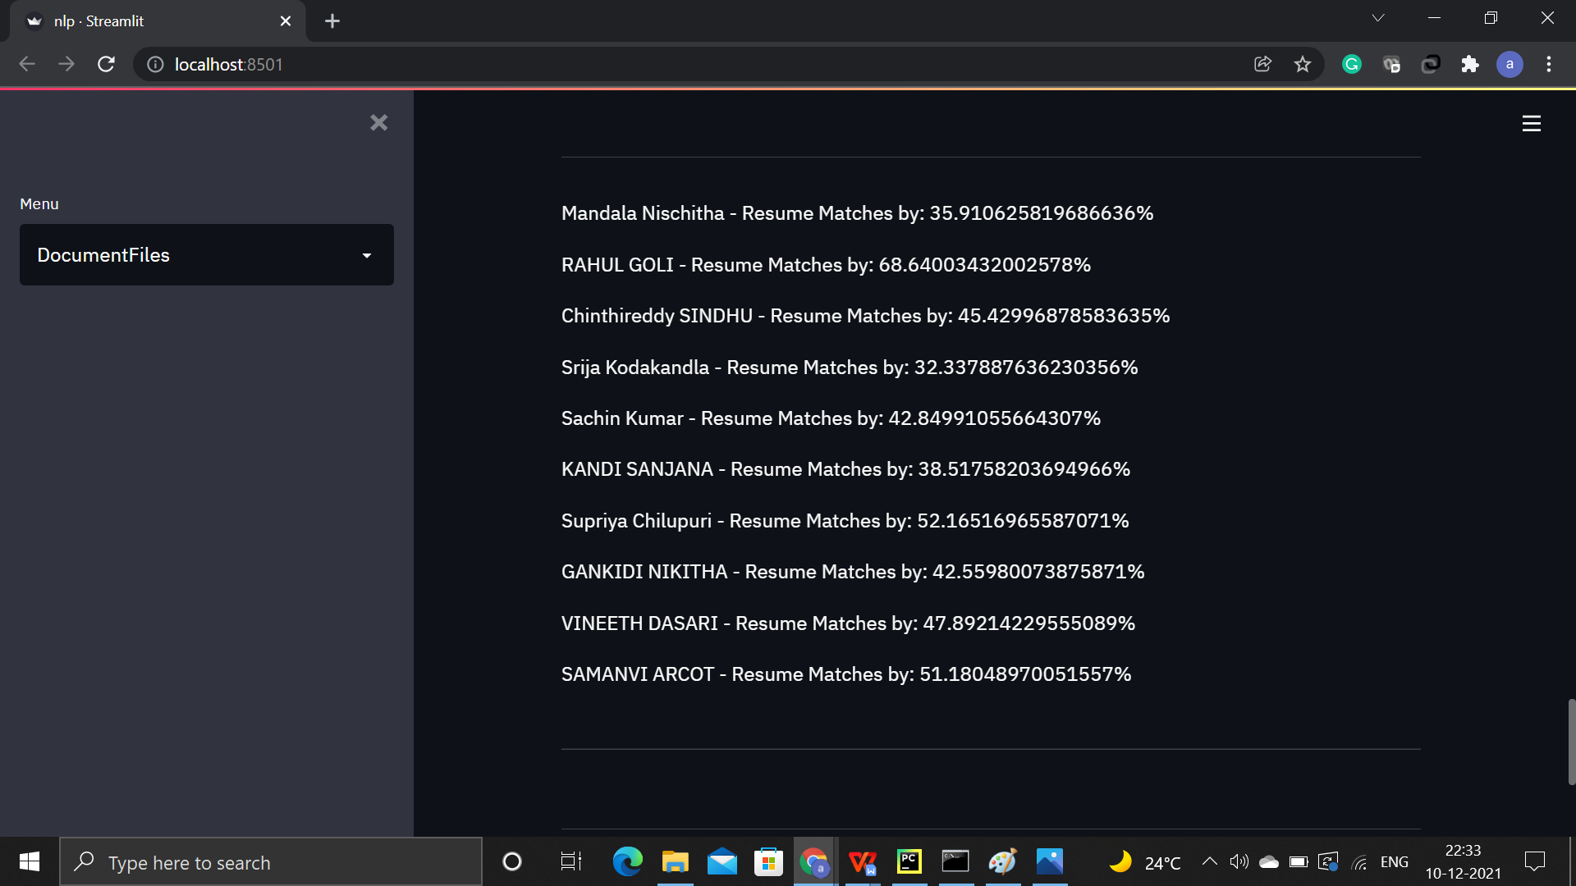
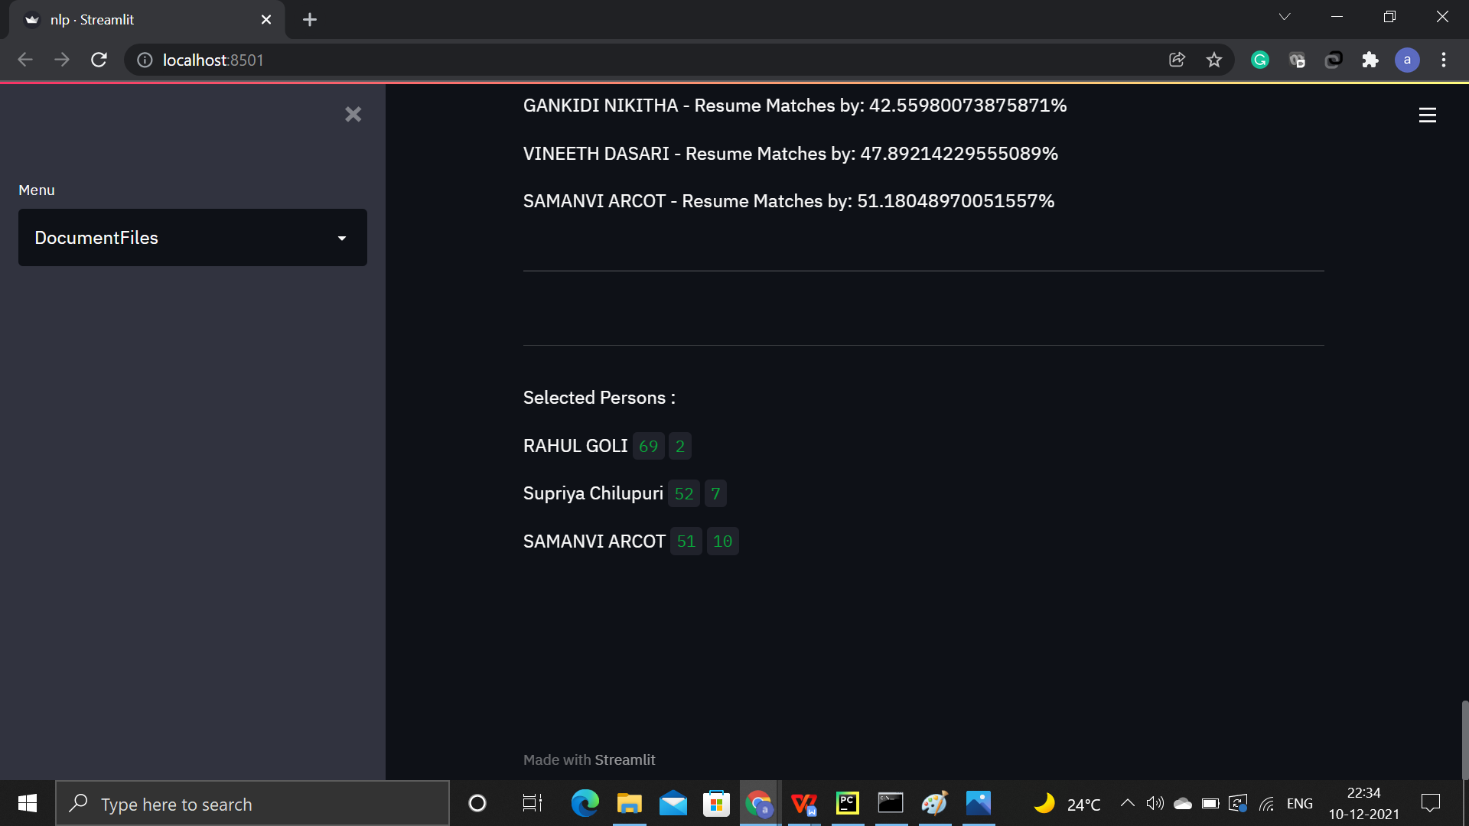

Slide 14


The process of deciding whether a candidate is qualified for a position based on student education, experience, and other information on their CV is known as resume screening. Frequently, the wrong individuals are chosen, delaying the hiring process. Hr and recruiting team are unable to decide the good candidates from the applications. So, we are trying to develop a website that compares the role/job description with the resumes of different students. We are comparing around 10 resumes with the job profile and printing the matching percentage. After finding the percentage, if the percentage is greater than 50 then, we select the candidates. This application will help Hr and recruiting team. In the future, we want to increase the number of resumes uploaded in the resume.
CONCLUSION

Slide 15
REFERENCES
Sujit Amin et all. “Web Application for Screening Resume”. Published on January 2019.https://ieeexplore.ieee.org/document/8945869
Nirali Bhaliya et all. “NLP based Extraction of Relevant Resume using Machine Learning”. https://www.ijitee.org/wpcontent/uploads/papers/v9i7/F4078049620.pdf
3. Daryani, Chirag & Chhabra, Gurneet & Patel, Harsh & Chhabra, Indrajeet & Patel, Ruchi. (2020). AN AUTOMATED RESUME SCREENING SYSTEM USING NATURAL LANGUAGE PROCESSING AND SIMILARITY. 99-103. 10.26480/etit.02.2020.99.103.
4. https://www.irjet.net/archives/V7/i7/IRJET-V7I7490.pdf
5. https://chatbotslife.com/ranking-resumes-for-a-given-job-description-using-natural-language-processing-a-toy-project-1f49d3156b44
http://www.aiktcdspace.org:8080/jspui/handle/123456789/1553
https://ieeexplore.ieee.org/abstract/document/8945869
https://www.sciencedirect.com/science/article/pii/S2666285X21001011
The importance of representative design in judgment tasks: The case of résumé screening-Barbara A. Fritzsche,Michael T. Brannick

Slide 16
THANK YOU

